Slide 1

Partnering with Management to Support Growth
Transforming Niche Market Leaders in the Lower Middle Market
Dubin Clark partners with outstanding management teams with the goal of building world class businesses. Our cooperative approach includes providing the capital necessary to support internal growth, completing add-on acquisitions to build market share, and developing new and innovative strategies for the future, all while protecting the independence, culture and values that made the company successful.
1984
Established
$400M+
Current
AUM
100+
Total
Transactions
15
Current Portfolio
Companies
20
Team
Members
Philosophy
Invest for the long-term success of the business
Maintain values and culture – build on what has already been achieved
Encourage continuity of management and path for future advancement
Ensure additional capital is available to support future growth
Complement internal growth with targeted add-on acquisitions
Criteria
Branded niche manufacturers and specialty service providers
Revenue: $5-100M+
EBITDA: $1-10M+
Adjusted EBITDA margin: >10%
Founder-owned, family-run businesses
Minimal customer concentration
Headquartered in United States
Investing Where We Have Expertise
Actively searching for opportunities in the following segments:
Residential & Business Services (exterior services, HVAC, plumbing, pest control, lawn spray, tree service, etc.)
Commercial & Facility Services (water / mold remediation, property management, pipe maintenance)
Event Services (rental equipment & services for weddings, corporate events, sporting events, etc.)
IT Services (managed services, migration services, security services, strategy and business transformation)
Automotive (collision, aftermarket parts, truck, Jeep, EV, golf cart, etc.)
Active Capital Invested in the USA
Investments by Industry
96%
First Institutional Equity^{(a)}
$358M +
$52M
$22M
Branded Niche Mfg.
96%
Deals Sourced Outside of Major U.S. cities^{(a)}
$99M
Event Services
$37M
Residential Services
$53M
HQ
Digital Services
72%
Purchase Price <6.0x^{(a)}
$95M
HQ
Dubin Clark Offices
Since 2011 as of 12/31/2023.
Dubin Clark & Company, Inc.
HQ - 1030 Second Street South
Jacksonville Beach, FL 32250
500 South Pointe Drive
Miami Beach, FL 33139
Office: (904) 799-1984
www.dubinclark.com

Slide 2



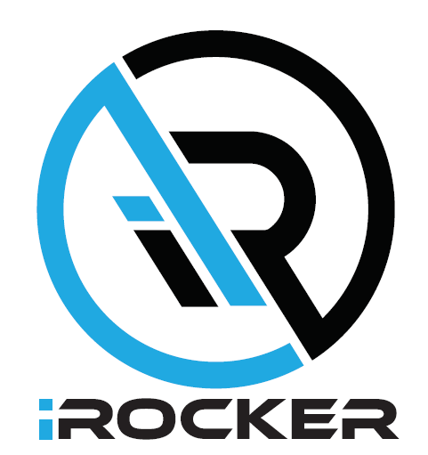
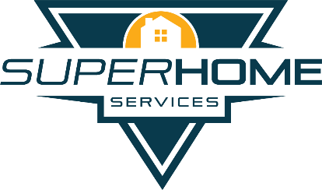
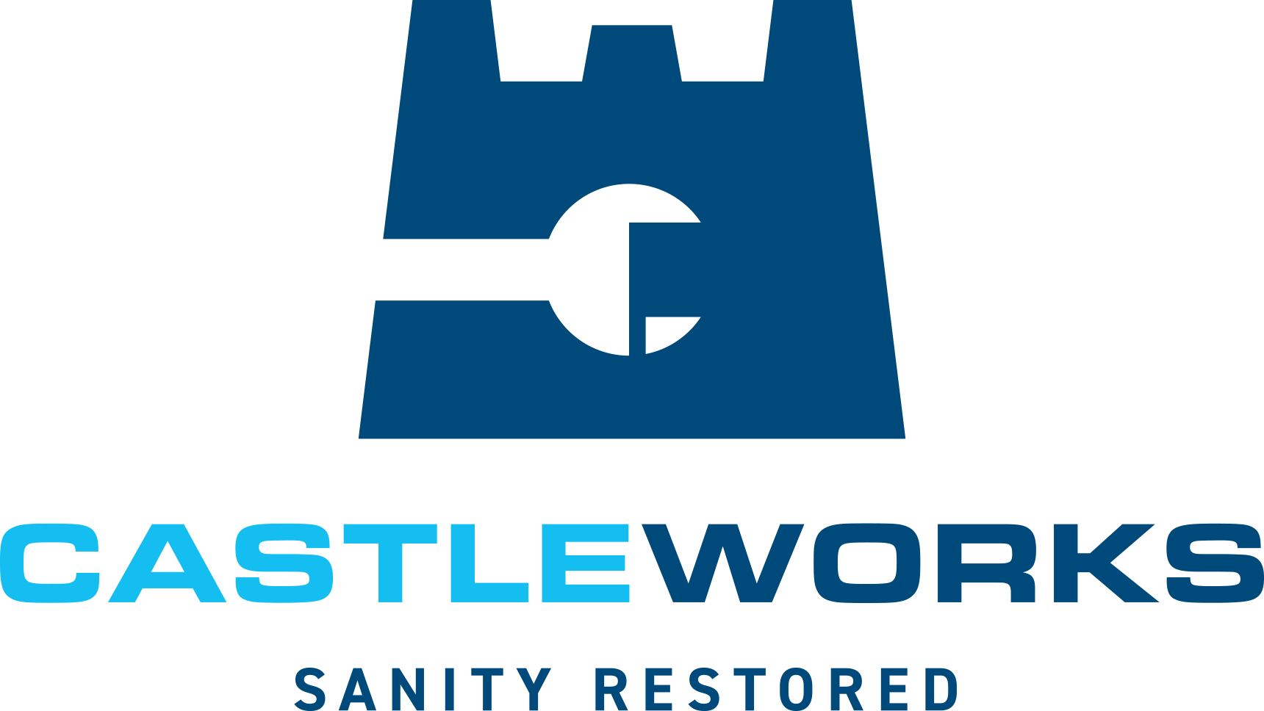


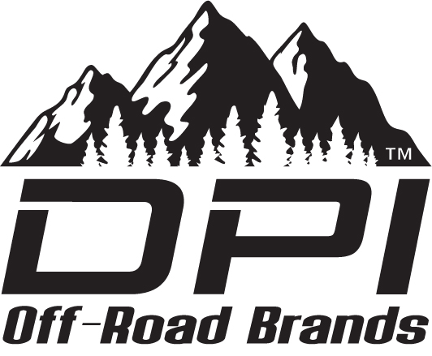


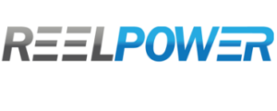
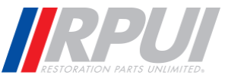
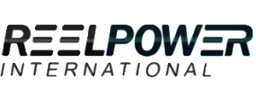
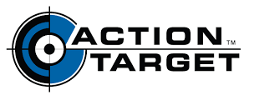
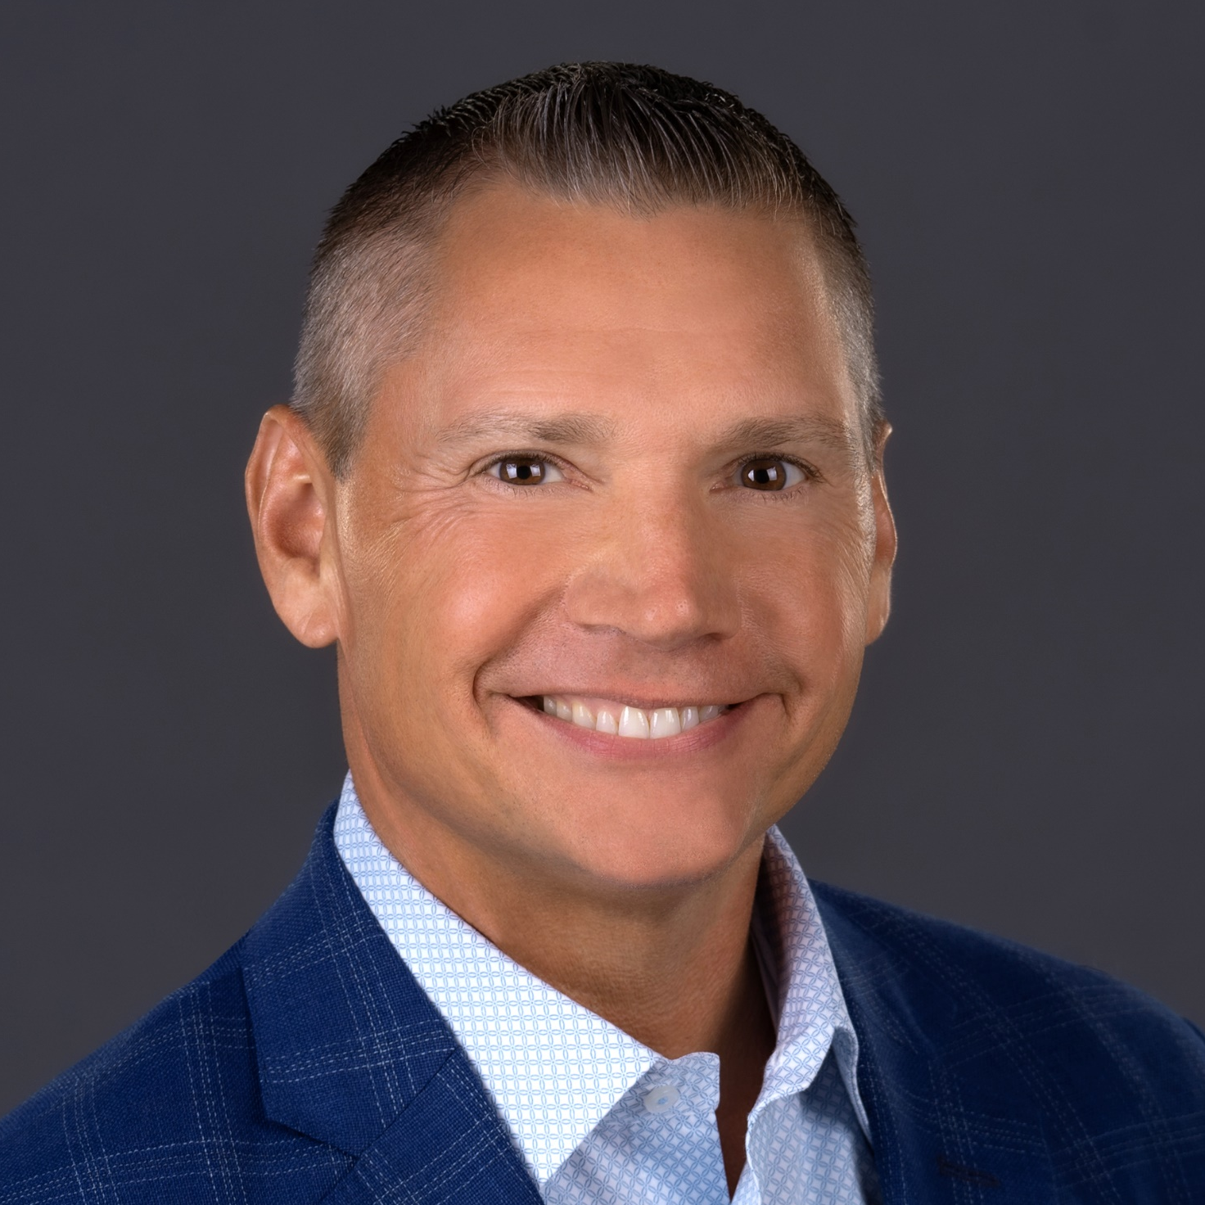
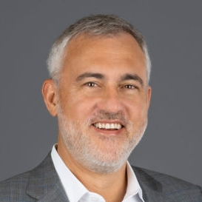
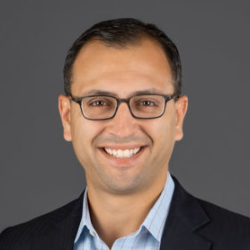
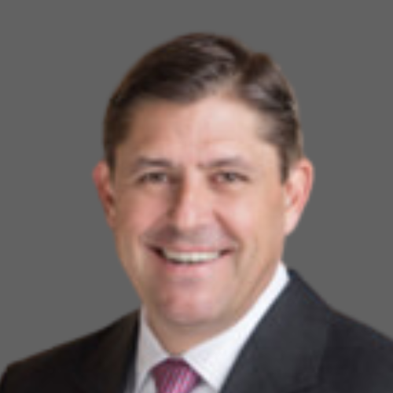

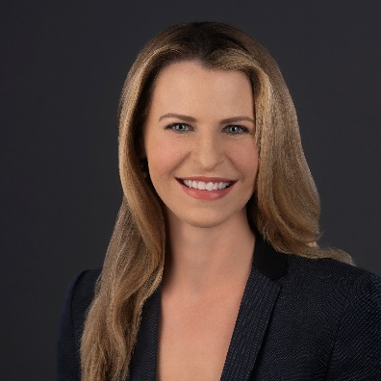
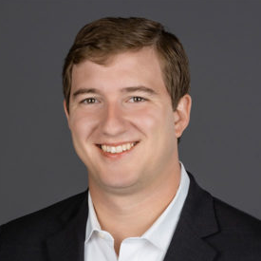
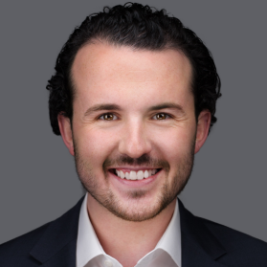
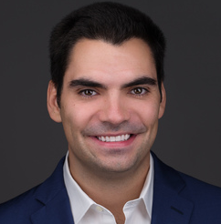
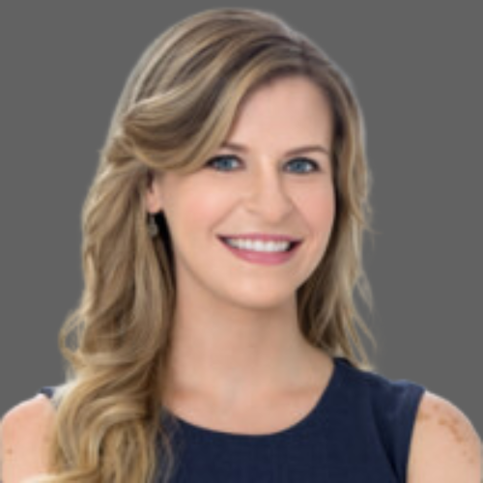
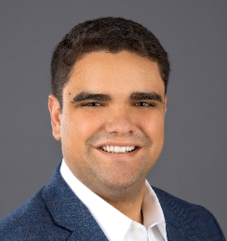
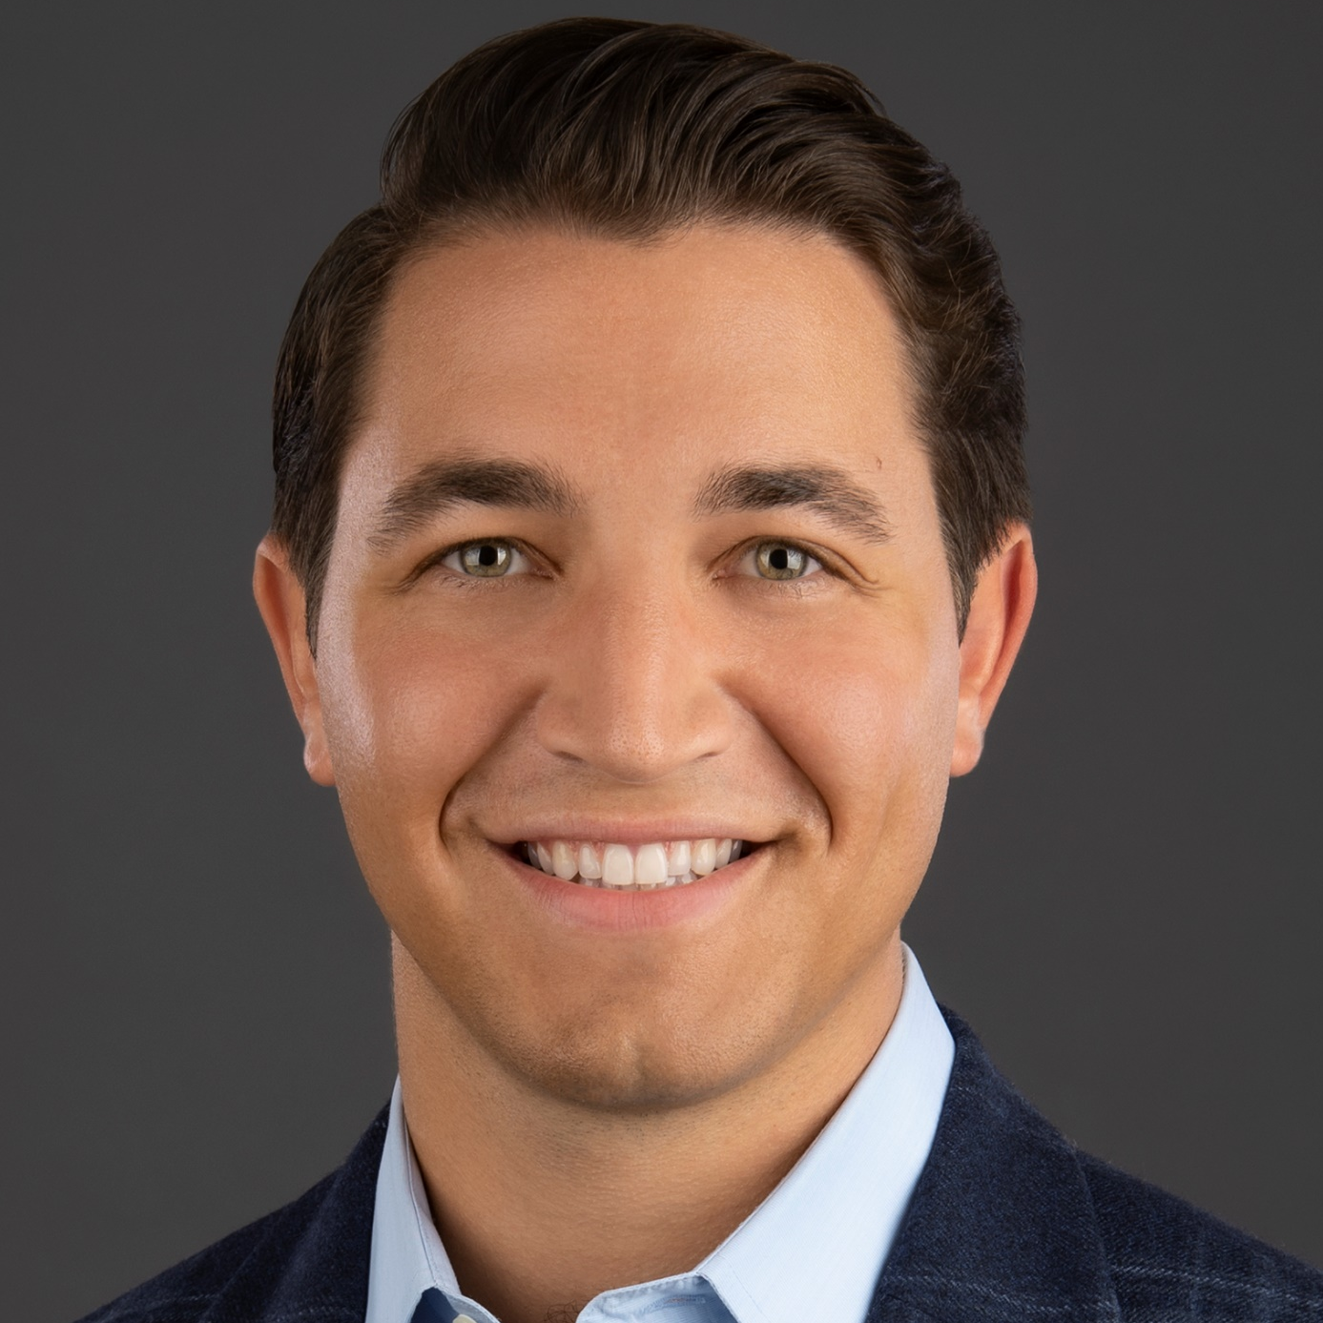
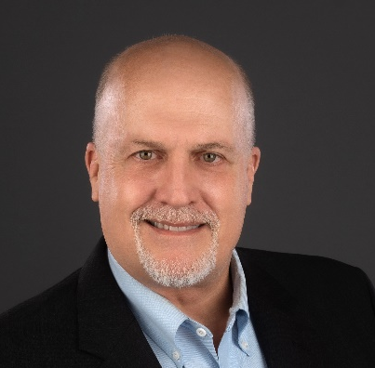
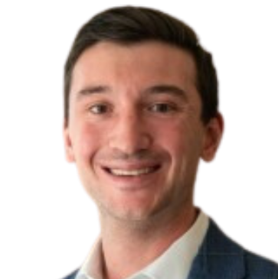
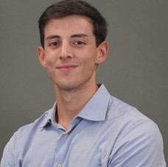
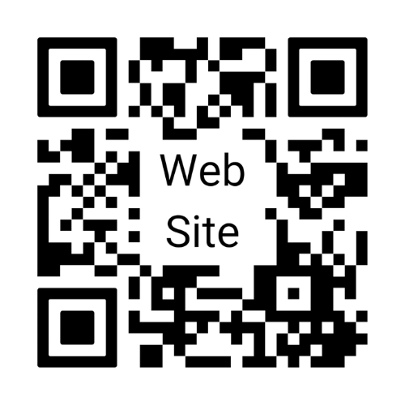
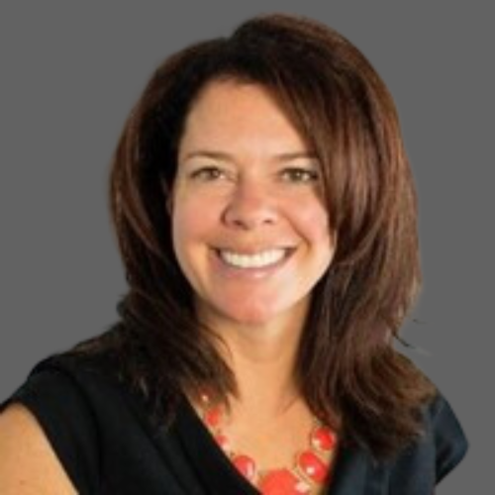
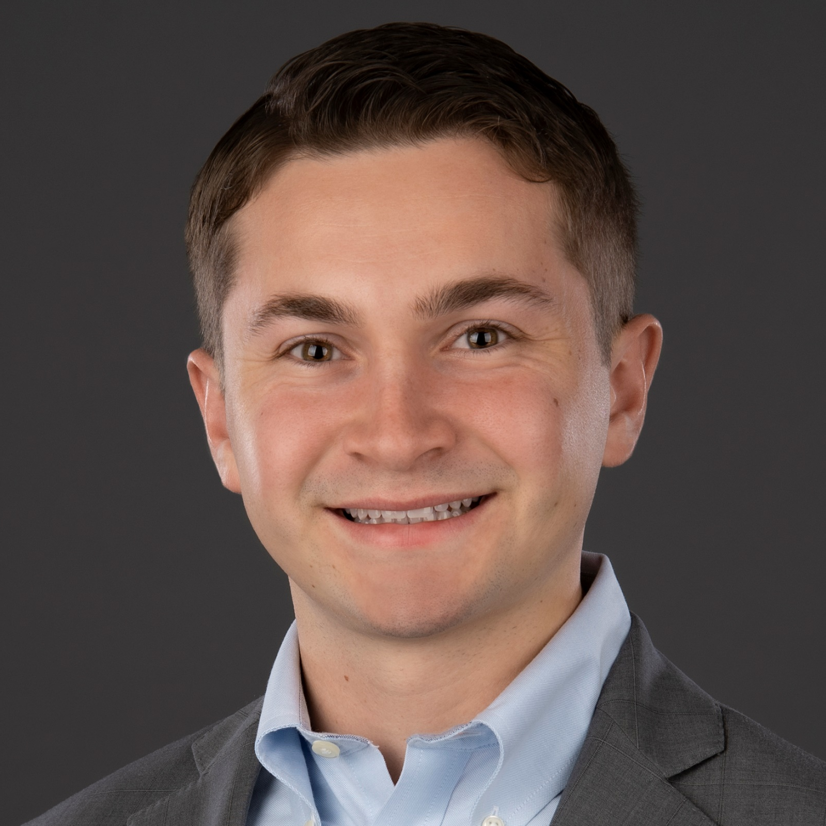
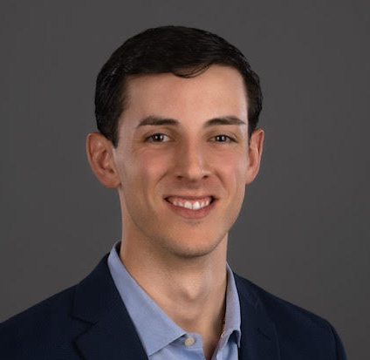
Current Portfolio
Ecosystems
Provider of non-discretionary home services offering sprinkler system care and winterization
December 2022 | Add-Ons: 3 | St. Louis, MO
Super Heat & Air
HVAC replacement, repair, and installation provider in the southeast region
December 2022 | Tampa, FL
Level Agency
Provider of direct response digital marketing services to B2B and B2C clients
September 2022 | Add-Ons: 1 | Pittsburgh, PA
CustomDrive
Full-service provider of low-speed personal transportation vehicles (Golf Cars and UTVs)
December 2021 | Summerfield (The Villages), FL
iROCKER
Designer and provider of watersports products and accessories
March 2021 | Jacksonville, FL
Super Home Services
Provider of concierge-level external home services in the Southeastern United States
July 2021 | Add-ons: 4 | Wake Forest, NC
CastleWorks
Residential water heater and HVAC replacement, repair, and installation services
July 2020 | Add-ons: 5 | Valencia, CA
SmartSource
Interactive technology solutions, rental equipment, and supporting infrastructure
October 2018 | Add-ons: 1 | Glendale Heights, IL
Euro Motorparts Group
Aftermarket automotive parts with a focus on parts for European vehicles
July 2018 | Add-ons: 3 | Anaheim, CA
DPI Off-Road Brands
Aftermarket performance parts for trucks, Jeeps, and multi-purpose vehicles
June 2017 | Add-ons: 6 | Phoenix, AZ
Marquee Event Group
Full-service event service company for social and corporate events in the South & Midwest
February 2016 | Add-ons: 6 | McCook, IL
United Safety & Survivability Corporation
Seating and safety solutions for a variety
of markets
July 2015 | Add-ons: 7 | Exton, PA
Reel Power
Provides material handling capital equipment to the industrial, marine, and energy markets
August 2008 | Add-ons: 2 | Oklahoma City, OK
Restoration Parts Unlimited
Manufacturer of classic automotive restoration parts and accessories
November 2012 | Add-ons: 6 | Lebanon, OH
Action Target
Leading provider of equipment and services for live-fire training facilities
May 2008 | Add-ons: 3 | Provo, UT
Investment Team
  Brent Paris
  Managing Partner
  Tom Caracciolo
  Managing Partner
  Mike Hompesch
  Partner
  Molly Simmons
  SBIC Operating Partner
  James Howe
  SVP of IR
  Matt Broullire
  Principal
  Tommy Cooperrider
  Principal
  Matt Laffey
  SVP of Investments
  Connor Bozzo
  Senior Associate
  Sam Zacharias
  Senior Associate,
  BD & IR
  Alex McDermand
  Associate
  Laura Paris
  Associate, BD
  Avi Wolf
  Analyst
  Dominick Berardi
  Analyst, BD
Dubin Clark & Company, Inc.
HQ - 1030 Second Street South
Jacksonville Beach, FL 32250
500 South Pointe Drive
Miami Beach, FL 33139
Office: (904) 799-1984
www.dubinclark.com

